Slide 1
Interpreting U(T,V)
Ideal gas molecules don’t see each other. That means there can’t be any volume dependence of the internal energy on volume. In contrast, real gases have intermolecular interactions (esp. at low volume).
Translational and rotational parts of the internal energy are linear functions of $T$ (like $\frac{3}{2}RT$), but vibrational contributions tend to be nonlinear functions of $T$ (i.e., curved).

Slide 2
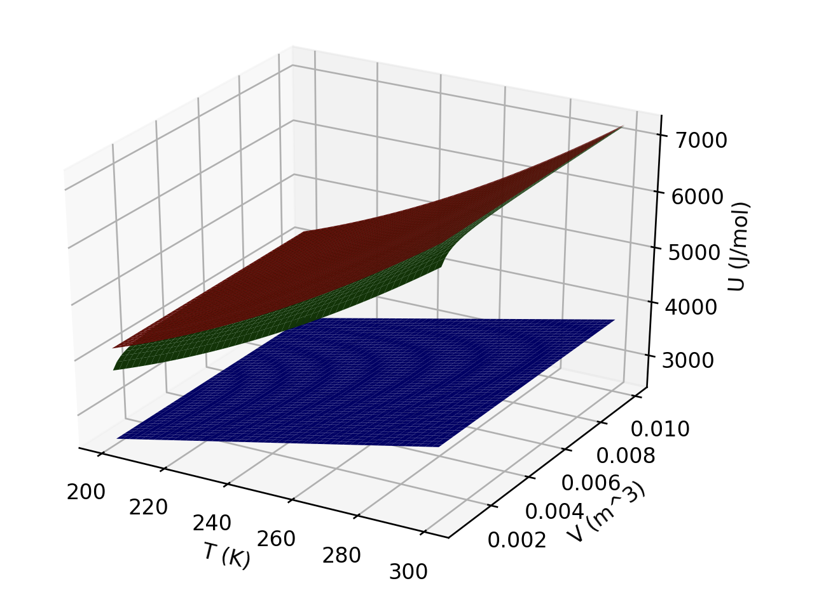
Interpreting U(T,V)
Which of these three gases could be ideal?
Which could be a monatomic gas?

Slide 3
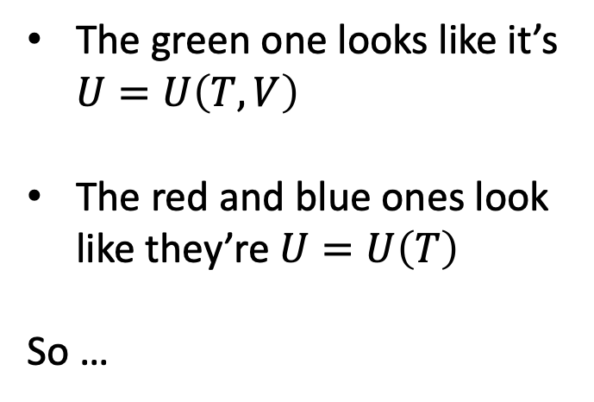
Interpreting U(T,V)
The green one looks like it’s $U=U\left(T,V\right)$
The red and blue ones look like they’re $U=U\left(T\right)$
So …

Slide 4
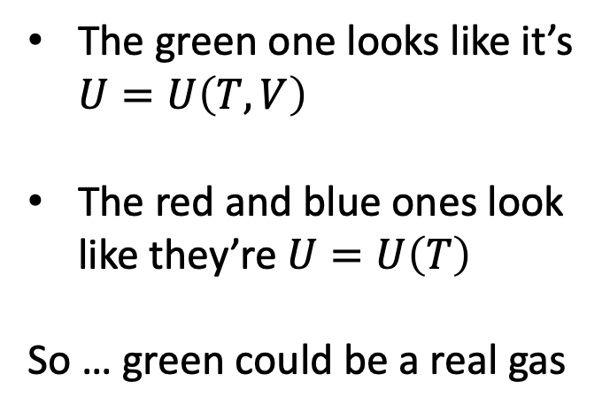
Interpreting U(T,V)
The green one looks like it’s $U=U\left(T,V\right)$
The red and blue ones look like they’re $U=U\left(T\right)$
So … green could be a real gas

Slide 5
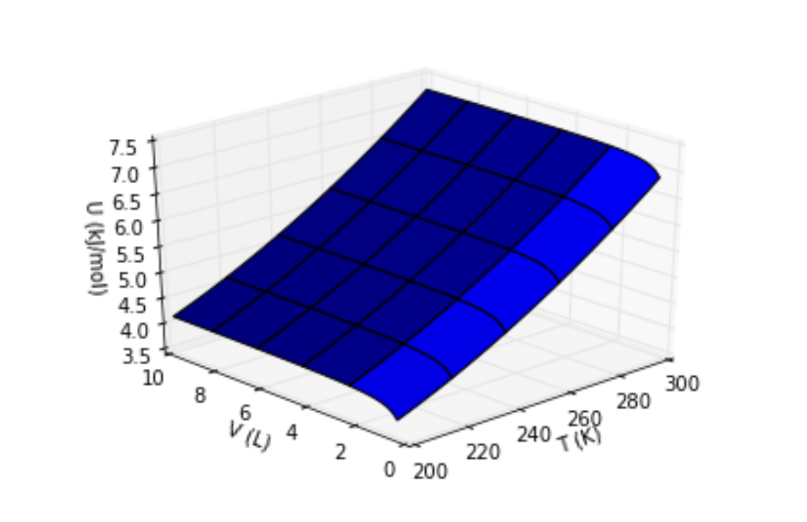

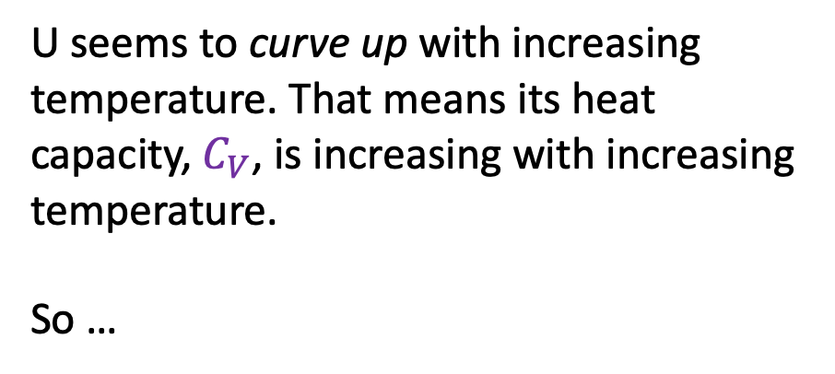

Interpreting the behavior of U in the temperature direction
$$π_{T}$$
$$C_{V}$$
U seems to curve up with increasing temperature. That means its heat capacity, $C_{V}$, is increasing with increasing temperature.
So …

Slide 6
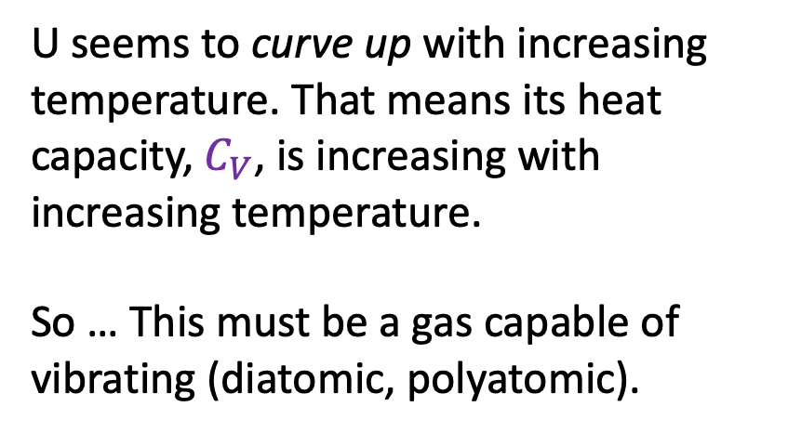
Interpreting the behavior of U in the temperature direction
$$π_{T}$$
$$C_{V}$$
U seems to curve up with increasing temperature. That means its heat capacity, $C_{V}$, is increasing with increasing temperature.
So … This must be a gas capable of vibrating (diatomic, polyatomic).

Slide 7
Interpreting U(T,V)
What kind of gas (real/ideal, monatomic or polyatomic) could this one be?

Slide 8
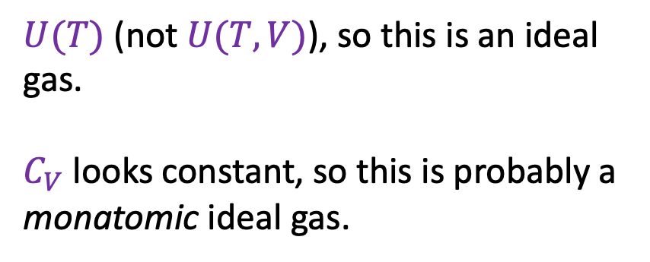
Interpreting U(T,V)
$U(T)$ (not $U(T,V)$), so this is an ideal gas.
$C_{V}$ looks constant, so this is probably a
monatomic ideal gas.
What kind of gas (real/ideal, monatomic or polyatomic) could this one be?

Slide 9

Interpreting the behavior of U in the volume direction
$$π_{T}$$
$$C_{V}$$
Yellow arrow corresponds to confining gas to smaller volumes

Slide 10

Interpreting the behavior of U in the volume direction
$$π_{T}$$
$$C_{V}$$
Why does U dip down at small volumes?
Yellow arrow corresponds to confining gas to smaller volumes

Slide 11
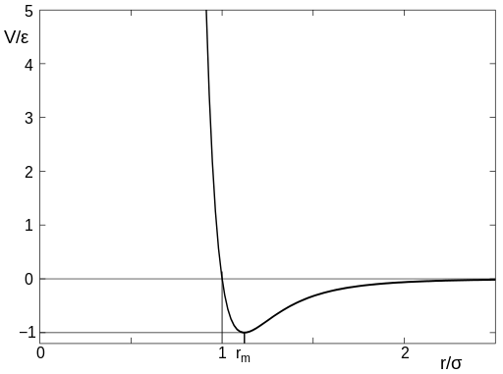
Interpreting the behavior of U in the volume direction
$$π_{T}$$
$$C_{V}$$
Why does U dip down at small volumes?
Potential Energy
Real
Intermolecular distances (d) are getting smaller. So lots of interactions are in the region of negative intermolecular potential energy.
d
Region of negative intermolecular potential energy

Slide 12
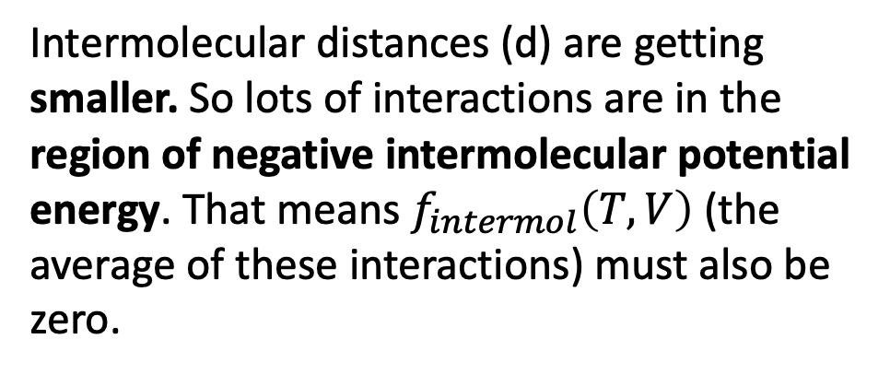
Interpreting the behavior of U in the volume direction
$$π_{T}$$
$$C_{V}$$
Why does U dip down at small volumes?
Potential Energy
Real
Intermolecular distances (d) are getting smaller. So lots of interactions are in the region of negative intermolecular potential energy. That means $f_{intermol}\left(T,V\right)$ (the average of these interactions) must also be zero.
d
Region of negative intermolecular potential energy

Slide 13
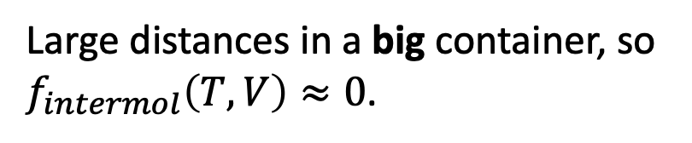
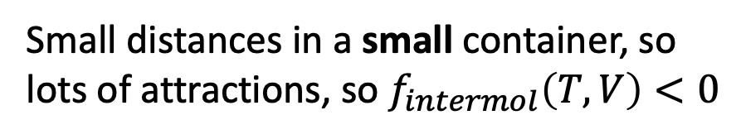
Interpreting the behavior of U in the volume direction
$$π_{T}$$
$$C_{V}$$
Why does U dip down at small volumes?
d
d
d
Large distances in a big container, so $f_{intermol}\left(T,V\right)≈0$.
Small distances in a small container, so lots of attractions, so $f_{intermol}\left(T,V\right)<0$

Slide 14
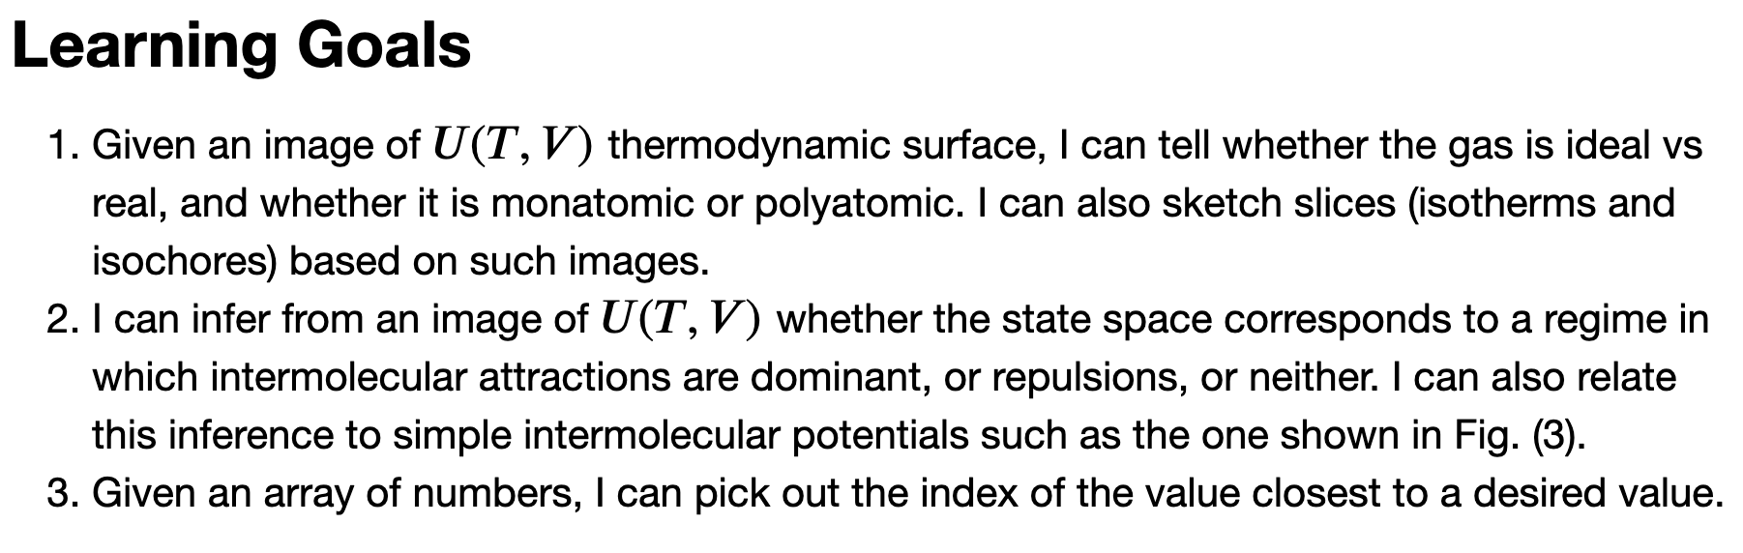
Key take-homes

Slide 15
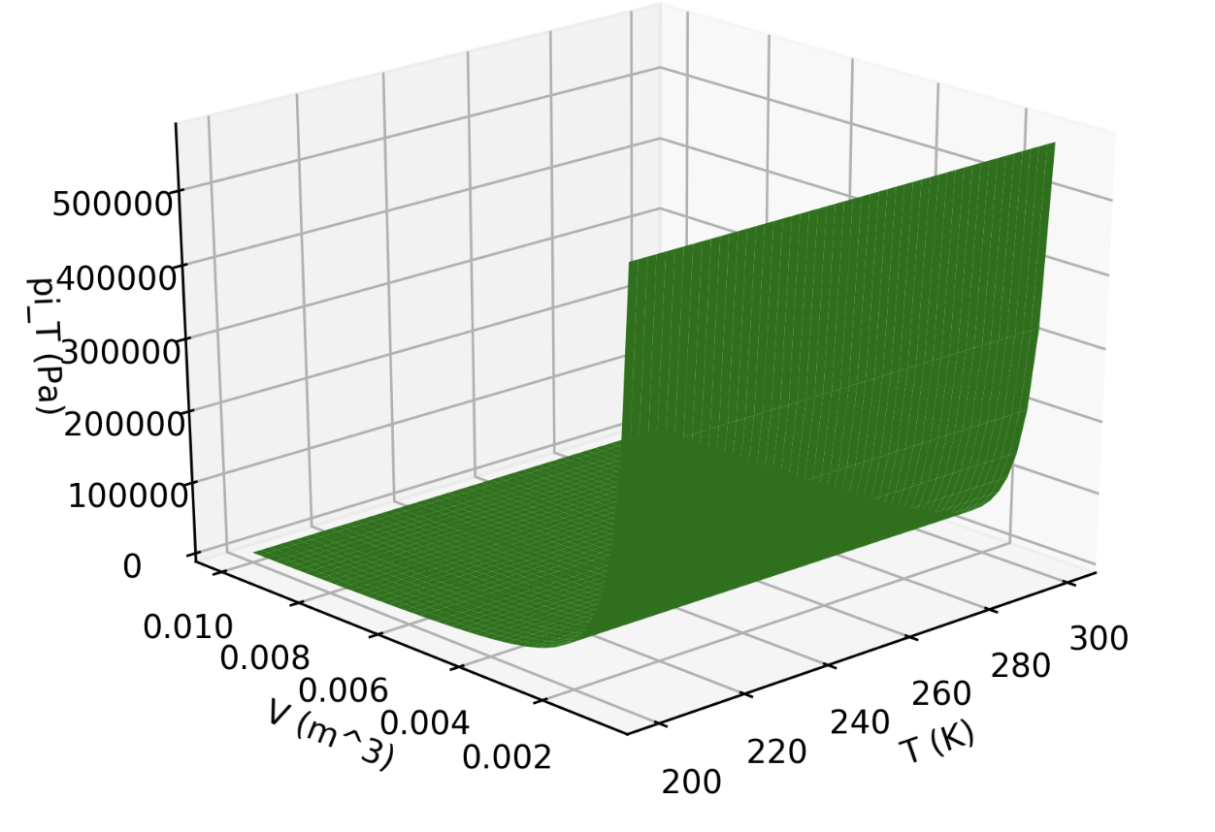
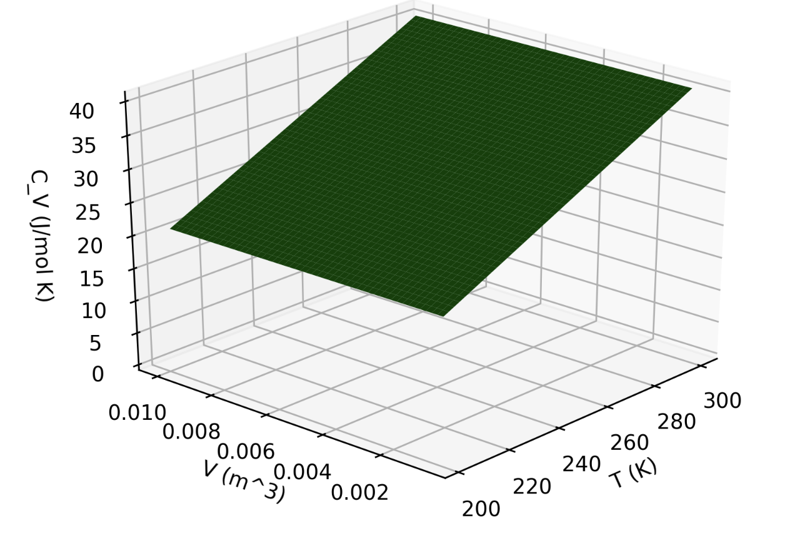

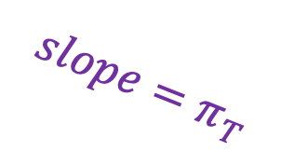

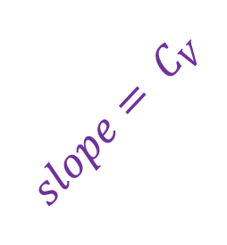

Differential calculus gets us this direction
$$π_{T}(T,V)$$
$$U(T,V)$$
$$slope=π_{T}$$
$${slope= C}_{V}$$
$$C_{V}(T,V)$$

Slide 16
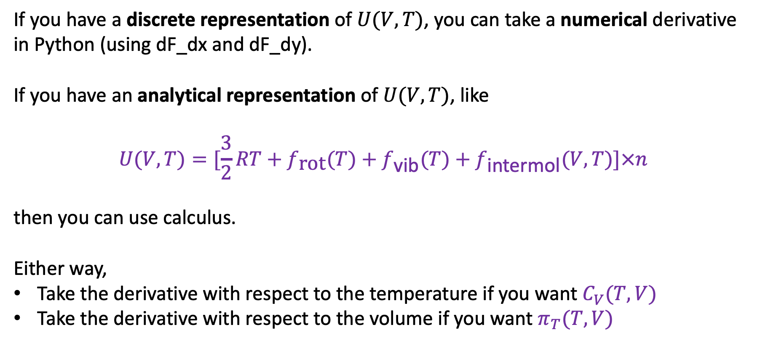
When to use numerical or analytical methods of differential calculus
If you have a discrete representation of $U(V,T)$, you can take a numerical derivative in Python (using dF_dx and dF_dy).
If you have an analytical representation of $U(V,T)$, like
$$U(V,T)=[\frac{3}{2}RT+f_{\text{rot}}(T)+f_{\text{vib}}(T)+f_{\text{intermol}}(V,T)]×n$$
then you can use calculus.
Either way,
Take the derivative with respect to the temperature if you want $C_{V}(T,V)$
Take the derivative with respect to the volume if you want $π_{T}(T,V)$

Slide 17
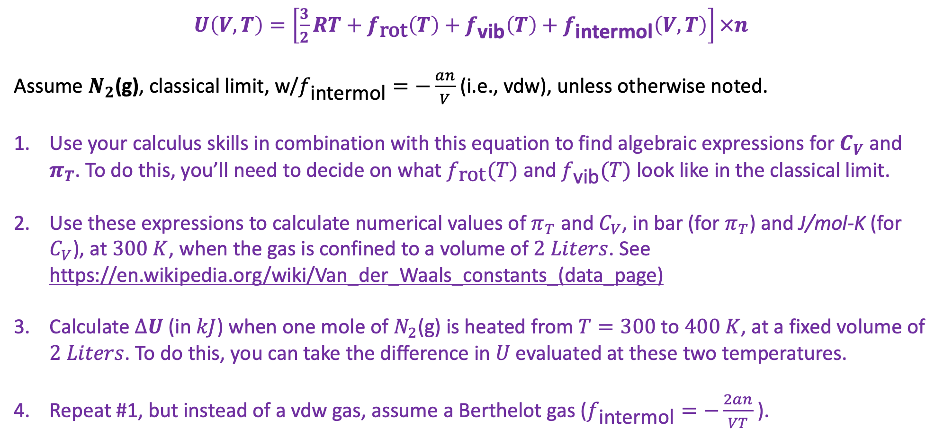
Problems to do on the board (submitting as CGI AnalyticalU)
$U\left(V,T\right)=\left[\frac{3}{2}RT+f_{\text{rot}}\left(T\right)+f_{\text{vib}}\left(T\right)+f_{\text{intermol}}\left(V,T\right)\right]×n$
Assume $N_{2}$(g), classical limit, w/$f_{\text{intermol}}=−\frac{an}{V}$ (i.e., vdw), unless otherwise noted.
Use your calculus skills in combination with this equation to find algebraic expressions for $C_{V}$ and $π_{T}$. To do this, you’ll need to decide on what $f_{\text{rot}}(T)$ and $f_{\text{vib}}(T)$ look like in the classical limit.
Use these expressions to calculate numerical values of $π_{T}$ and $C_{V}$, in bar (for $π_{T}$) and J/mol-K (for $C_{V}$), at $300 K$, when the gas is confined to a volume of $2 Liters$. See https://en.wikipedia.org/wiki/Van_der_Waals_constants_(data_page)
Calculate $∆U$ (in $kJ$) when one mole of $N_{2}$(g) is heated from $T=300$ to $400 K$, at a fixed volume of $2 Liters$. To do this, you can take the difference in $U$ evaluated at these two temperatures.
Repeat #1, but instead of a vdw gas, assume a Berthelot gas ($f_{\text{intermol}}=−\frac{2an}{VT}$).

Slide 18
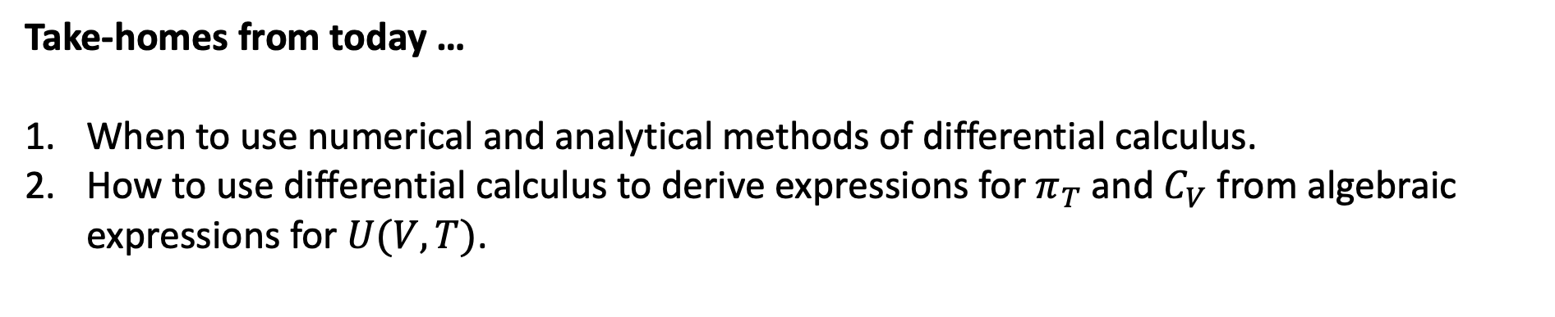
Take-homes from today …
When to use numerical and analytical methods of differential calculus.
How to use differential calculus to derive expressions for $π_{T}$ and $C_{V}$ from algebraic expressions for $U(V,T)$.

